Slide 1

CVE 511
INDUSTRIAL ECONOMICS

Slide 2
LECTURER: DR. O.B. OKEDERE
Text Books:
Industrial Economics : R.R. Barthwal
Industrial Economics : Ranjana Seth

Slide 3
Synopsis
Law of management economics, management models, revenue of the firms, production decision, cost of production, profit analysis of the firms, pricing techniques location and localization of industries, industrial growth in Nigeria, the size of the firm integration and diversification marketing; demand and forecasting. Distributive trade in Nigeria, business finance, investment, capital budgeting and management control. Government policies and firm. Financing Technology: Capital equipment investment appraisal methods. Break even analysis. Budgeting and financial control. Fundamentals of cost accounting with emphasis on production costing. Areas of conflicts between Engineering valuation. Management: Organzational structure and behavior, engineer to engineer manager transition, managerial functions, principles and techniques of planning, forecasting organizing technical activities, project selection and management, style of leadership and management techniques.

Slide 4
Introduction
Managerial economics is concerned with the application of economics concepts and economic analysis to the problems of formulating rational managerial decisions. (Mansfield)
It is a discipline that combines economic theories with managerial practices and helps to recover the gap between the problem of logic and policy.

Slide 5
Scope of Managerial Economics
The most important function in managerial economics is decision making. It involves selecting the most suitable action from two or more alternatives.
Economic theories and analysis are used to solve problems of managerial economics.
Economics comprises two main divisions; micro and macro economics
Microeconomics covers the analysis of small individual units of economy such as individual firms, industry or a single individual consumer while macroeconomics deals with the study of the entire economy and considers all factors such as government policies, GDP national income, unemployment etc.

Slide 6
Scope Cont’d
Demand and Supply between individuals
Total Economic environment
Consumers,
Buyers,
Vendors
Studies related to local, regional and global economics
All the economic theories, tools and concepts are covered under the scope of managerial economics

Slide 7
Concept of Demand
Demand means the ability and willingness to buy a specific quantity of a commodity at a given price and at a particular time.
Law of Demand states that the quantity of a commodity demanded in a given time period increases as price falls, other things being equal (Ceteris paribus)
Demand Schedule: This is a table showing the quantity of goods that a consumer is willing and able to buy at a prevailing price in a given period of time.

Slide 8
Concept of Demand Cont’d
Price | Quantity Demanded
50 | 1
45 | 2
40 | 3
35 | 4
30 | 7
25 | 12
15 | 15

Slide 9
Concept of Demand Cont’d
Demand Curve: It is a curve indicating the total quantity of a product that consumers are willing and able to purchase at the prevailing price level holding the price of related goods, income and other variables constant.
Price (Y – axis)
Demand curve
Quantity Demanded (x – axis)

Slide 10
Shift in Demand
A shift in demand curve occurs when the determinants of demand change. When taste and preferences and income are altered, the basic relationship between price and quantity demanded changes (shifts). The shift in the entire demand curve upward and is called increase in demand because more of the commodity is demanded at that price. A downward shift is called decrease in demand.
D₁
D
D_{o}
Price
D₁
D
D_{o}
Quantity Demanded

Slide 11
Shift in Demand Cont’d
The movement along a demand curve can take place (extension and contraction) due to price rise or fall. When price falls, more of the commodity is purchased, there will be an extension of the demand curve and vice versa for contraction.
D
P₁
a
P
b
Price
P_{O}
c
D
Q₁
Q
Q_{O}
Quantity Demanded

Slide 12
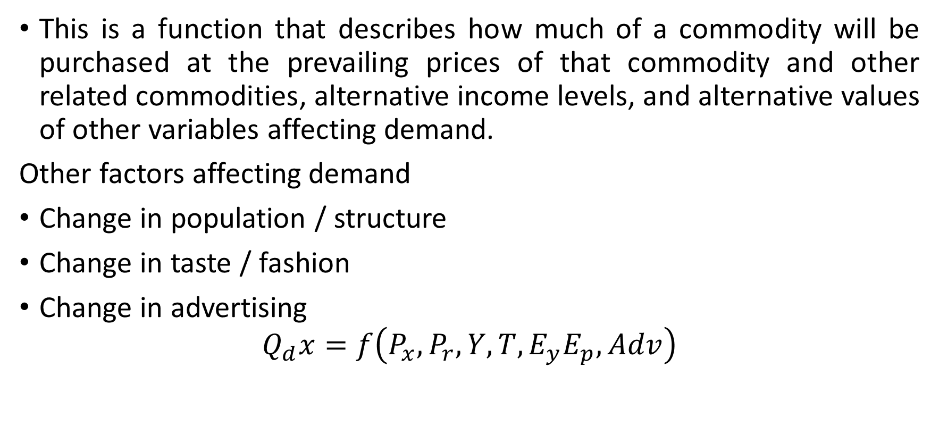
Demand Function

Slide 13
Factors affecting Demand
Price of Goods
Price of related goods (Substitute / complementary goods)
Income
Population
Value of Money
Weather condition
Advertisement
Expectation of future change in price

Slide 14
Factors affecting Demand
Government policy (taxation)
Availability of credit facilities
Multiplicity of users

Slide 15
Types of Demand
Direct and Indirect
Derived and autonomous
Durable and non durable goods demand
Firm and Industry demand
Total market / Segment demand
Short run / Long run demand
Joint / Composite demand
Price demand / Income demand / Cross demand

Slide 16
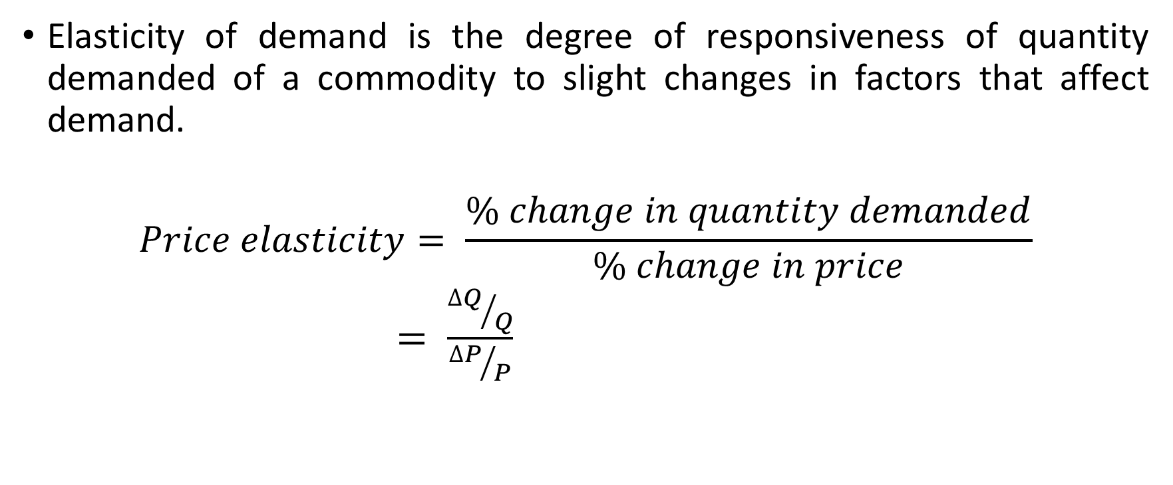
Elasticity of Demand

Slide 17
Elasticity of Demand Cont’d
Nature of the commodity
Extent of use
Range of substitutes
Income level
Proportion of income spent on commodity
Urgency of demand / postponement of purchase

Slide 18
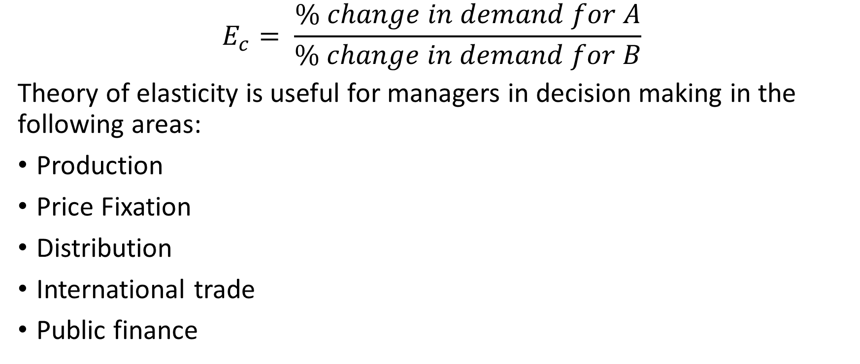
Cross Elasticity

Slide 19
Example
The demand for a product rises from 500 units to 600 units where the price of a particular product reduces from N25 000 to N22 000. Find the cross elasticity of demand for the two products. What is the nature of their relationship?

Slide 20
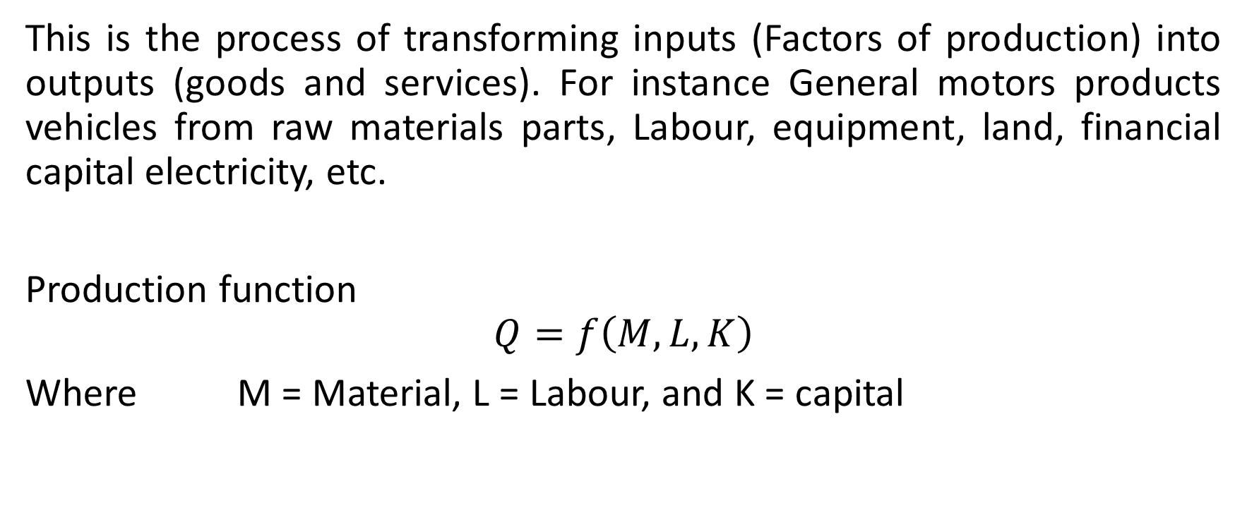
Production

Slide 21
Concepts of Costs
Concept of cost can be theoretically grouped into two over-lapping categories:
Concepts used for accounting purposes; and
Analytical cost concepts used in economic analysis of business activities.

Slide 22
Accounting cost concept
Opportunity cost and actual or explicit cost: Oportunity cost is the expected returns from the second best use of an economic resource while actual costs are those out of the pocket costs of labour, material, machine, plant building and other factors of production
Business and Full Costs: Business cost are all expenses incurred in carrying out business while full cost include: business cost, opportunity cost and normal profit.
Explicit and Implicit costs: Explicit costs are cash payments recorded in accounting practices such as wages, salaries, etc. while implicit cost are the cost that do not appear in business accounting system.

Slide 23
Analytical cost concept
Fixed and Variable costs: Fixed costs are costs that remain fixed in volume for a certain level of output while variable costs vary with variation in output. They include cost of raw materials.
Total, Average and Marginal costs: Total cost refers to the total expenditure on the production of goods and services. Average cost is obtained by dividing the total cost by the output Q, while marginal cost is the additional cost of producing one extra unit of a product.
Short Run and Long Run costs: Short run costs change as desired output changes given a constant size of firm, while long run costs are costs incurred on firm’s fixed assets such as plant, machinery and buildings, etc.
Other costs include: Incremental and sunk costs, Historical and replacement costs, private and social costs

Slide 24
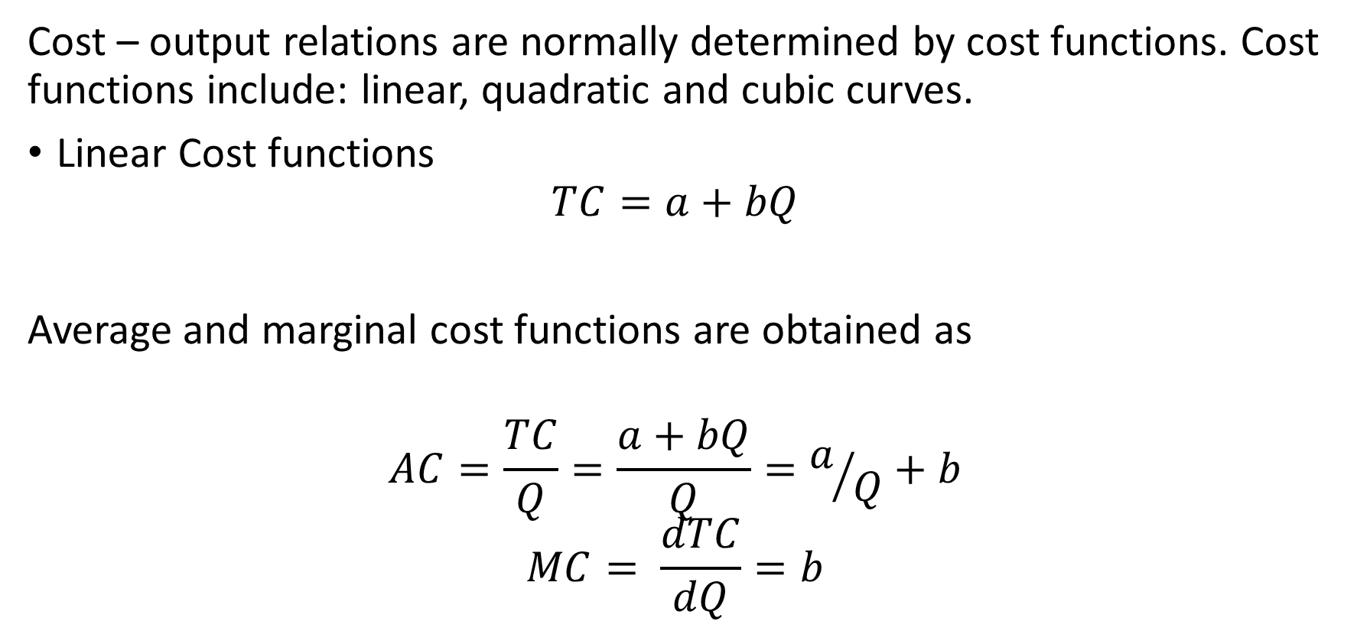
Cost Functions
Where a = Total fixed cost
bQ = Total variable cost

Slide 25
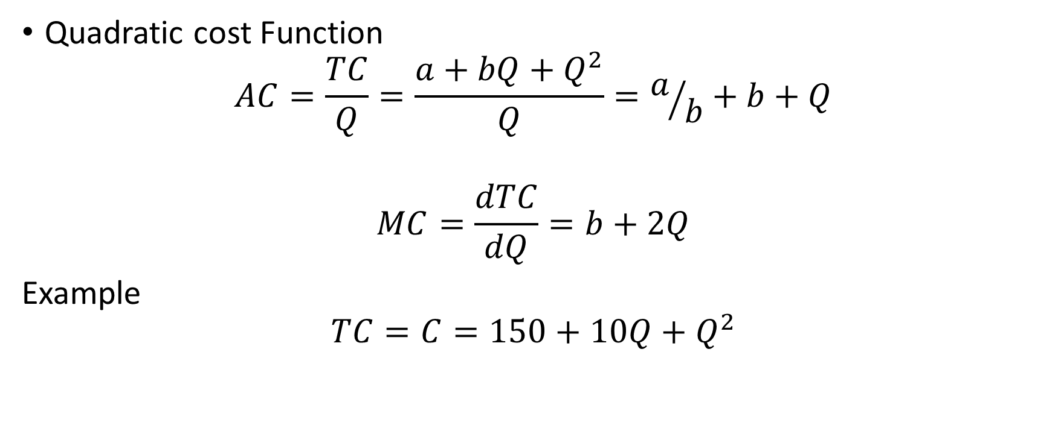
Cost Function Cont’d

Slide 26
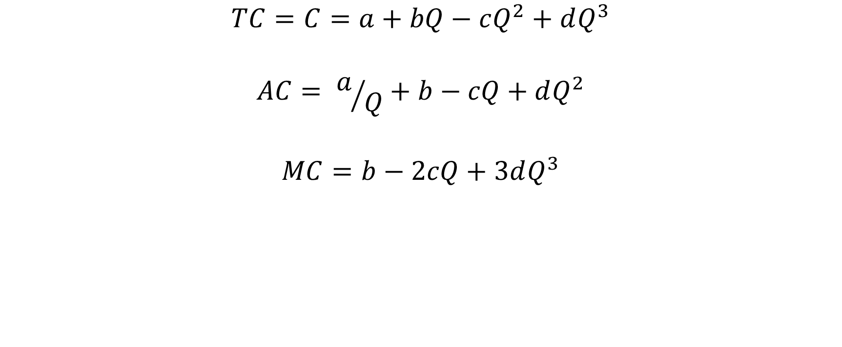
Cubic Cost Function

Slide 27
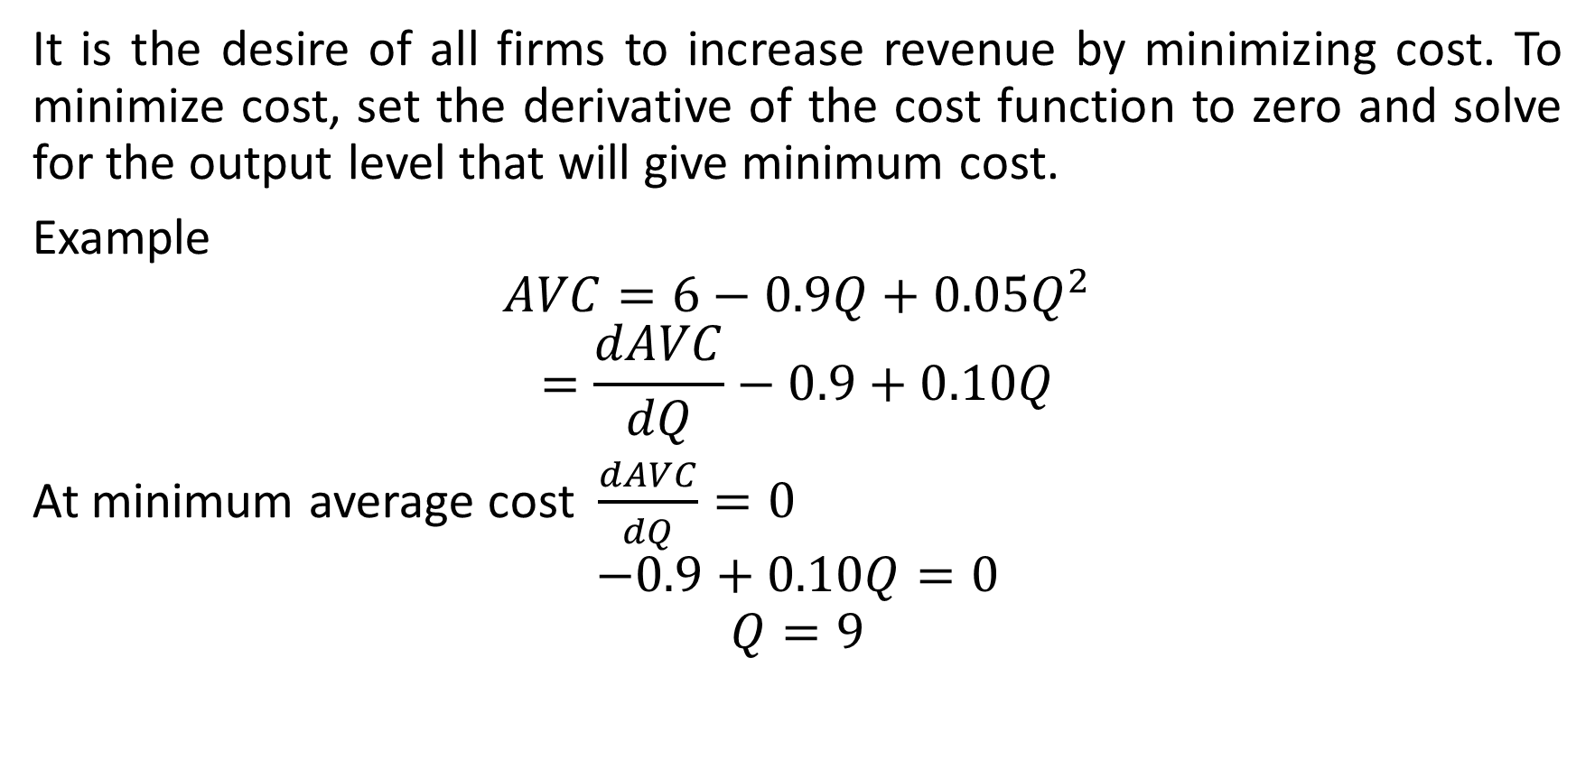
Cost Minimization

Slide 28
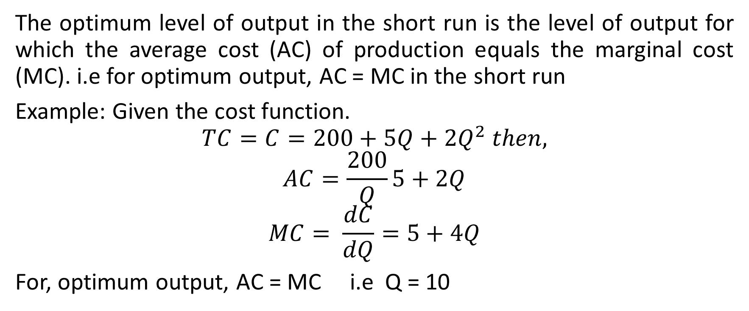
Output optimization in short run

Slide 29
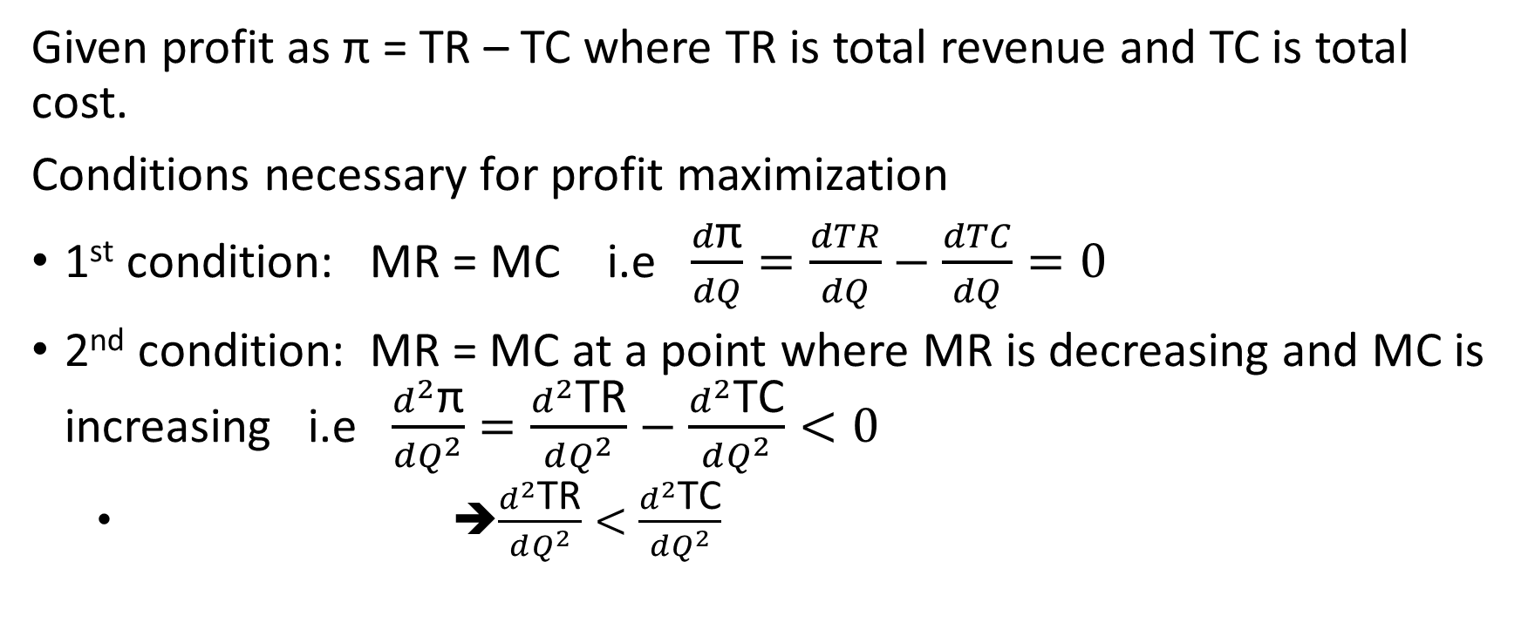
Maximization of profit

Slide 30
Break Even Analysis
Break even analysis is a useful and frequently employed technique for determining the volume of service/goods needed to ensure that revenue generated will exceed costs. Break even is attained when total revenue (TR) is equal to total cost (TC)
TR
TC
Cost / Revenue
FC
A
Volume of goods / services

Slide 31
Cont’d (Relevant equations)
TR = REV X N
VC = COST X N
TC = VC + FC
TR = Total Revenue
REV = Revenue generated per unit service
N = Number of unit or service provided
VC = Variable cost
TC = Total cost
FC = Fixed cost

Slide 32
Break Even Analysis Example
Pen Sold (Q) | 20 000 | 50 000 | 80 000
Total Sales (S) | 400 000 | 1 000 000 | 1 600 000
Variable Cost (V.C) | 240 000 | 600 000 | 960 000
Contribution Margin (CM) | 160 000 | 400 000 | 640 000
Fixed Cost (FC) | 400 000 | 400 000 | 400 000
Profit/Loss | 240 000 | 0 | 240 000

Slide 33
Time Value of Money (TVM)
It is a financial management concept that is used to compare investment alternatives and to solve problems involving loans, mortgages, leases, savings and annuities. It works on the concept that a unit amount of money received today is worth more than the promise or expectation of the same amount in future.
Terminologies
Interest, period, payments, present value, future worth, annuity, amortization, cash flow

Slide 34
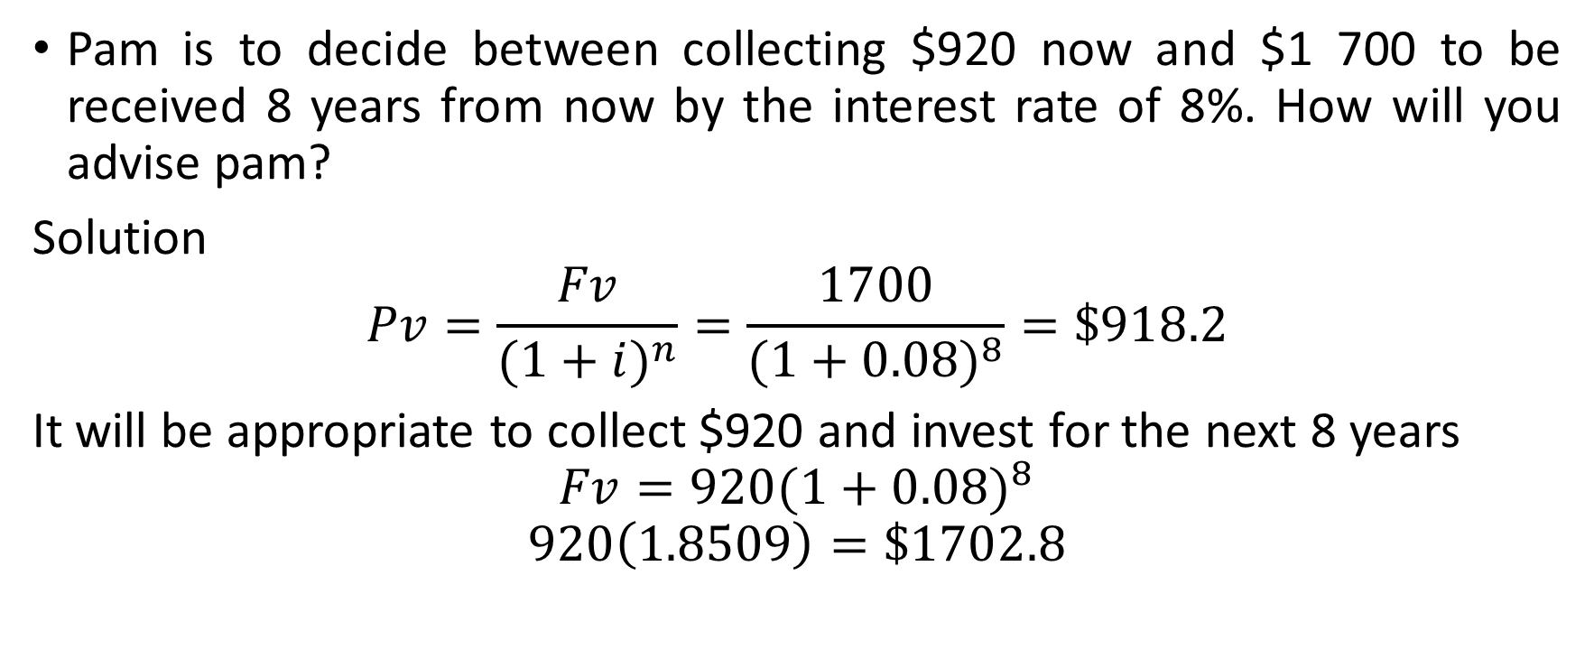
Example

Slide 35
Diversification
This is a form of corporate strategy for a company which seeks to increase profitability through greater sales volume obtained from new products and new markets.
Diversification strategies include:
Internal development of new products into markets
Acquisition of a firm
Alliance with a complementary company
Licensing of new technologies
Distribution or importing products manufactured by another firm.

Slide 36
Types of Diversification
Concentric diversification: This occurs when there is a technological similarity between the industries e.g. the addition of tomato ketchup and sauce to the existing maggi brand processed item.
Horizontal diversification: This occurs when a company adds new products or services that are often technologically or commercially unrelated to its current products but that may appeal to current customers
Conglomerate (Lateral Diversification): The company markets new products or services tat have no technological or commercial relation with current products but that may appeal to new groups of customers.

Slide 37
Demand Forecasting
A forecast is a prediction or estimation of a future situation, under given conditions. Demand forecast helps managers to make the following decisions effectively.
Short Run Decision | Long Run Decision
Purchase of inputs | Expansion of existing capacity
Maintenance of economic level of inventory | Diversification of the product mix
Setting up sales targets | Growth of acquisition
Distribution network | Change of location of plant
Management of working capital | Capital Issue
Price policy | Long run borrowing
Promotion policy | Manpower planning

Slide 38
Demand Forecasting Cont’d
Steps to be followed:
Identification of objectives
Nature of product and market
Determination of demand
Analysis of factors
Choice of Technology
Testing of Accuracy

Slide 39
Demand Forecasting Cont’d
Criteria for choice of forecasting
Accuracy
Plausibility
Durability
Flexibility
Availability

Slide 40
Forecast methods
Survey of buyer’s intention
Delphi method
Expert opinion
Collection opinion
Waive model
Smoothing technique
Time series / trend projection
Controlled experiments
Judgemental approach

Slide 41
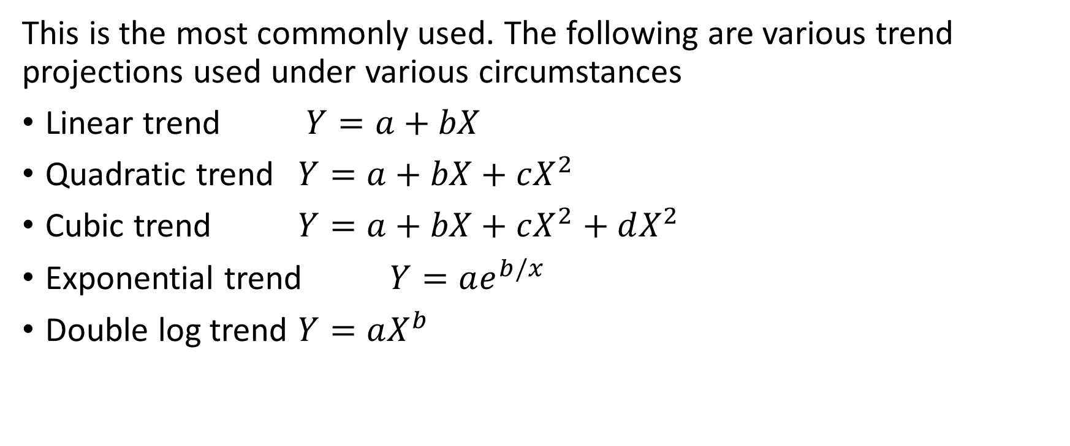
Time series / Trend projection

Slide 42
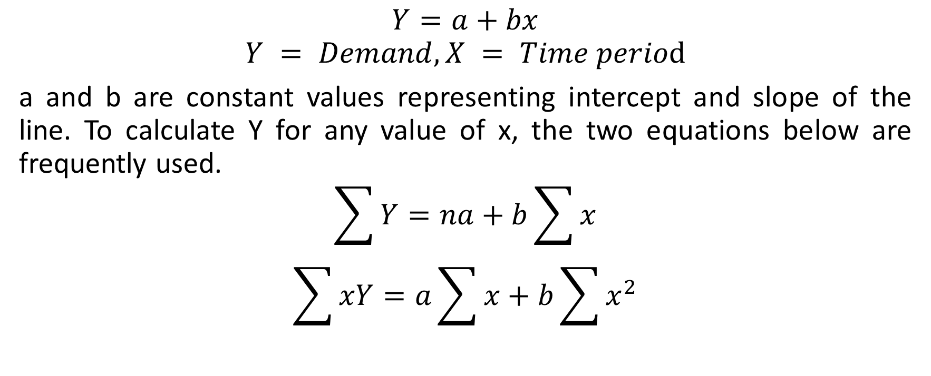
Linear Trend Equations

Slide 43
Example
Year | 2002 | 2003 | 2004 | 2005 | 2006 | 2007 | 2008 | 2009 | 2010 | 2011
Sales | 22734 | 24731 | 31489 | 44685 | 55319 | 91021 | 146234 | 107887 | 127483 | 97275
Estimate the sales for 2012 and 2015

Slide 44
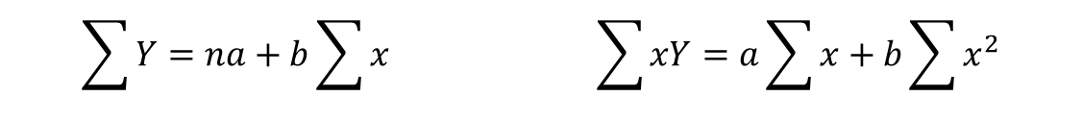
Solution
year | x | sales (Y) | XY | X²
2 | 1 | 22734 | 22734 | 1
3 | 2 | 24731 | 49462 | 4
4 | 3 | 31489 | 94467 | 9
5 | 4 | 44685 | 178740 | 16
6 | 5 | 55319 | 276595 | 25
7 | 6 | 91021 | 546126 | 36
8 | 7 | 146234 | 1023638 | 49
9 | 8 | 107887 | 863096 | 64
10 | 9 | 127483 | 1147347 | 81
11 | 10 | 97275 | 972750 | 100
sum | 55 | 748858 | 5174955 | 385

Slide 45
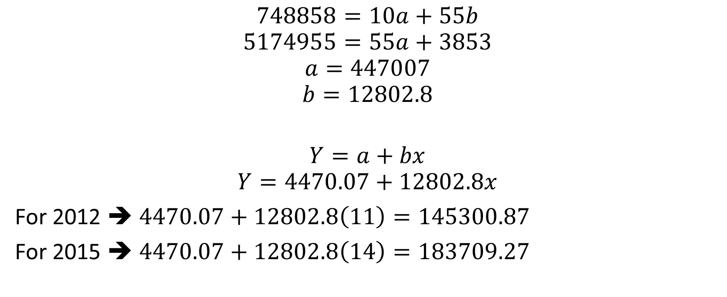
Soln cont’d

Slide 46
Trend in Series
Sales
* Sales (Y)
- Linear Sales (Y)
Year

Slide 47
Forecasting cont’d
Stationary series
Naïve method
Simple average method
Moving average method
Autoregressive moving average
Box Jenkins method
Forecasting trend series
Moving average
Simple regression
Growth curves
Exponential models
Autoregressive integrated moving average (ARIMA) models
Box Jenkins method
Seasonal series
Exponential smoothing
Multiple regression
Arima
Cyclical Series
Econometric models
Multiple regression
Arima

Slide 48
Forecasting cont’d
Other survey methods are:
Complete enumeration method
Sample survey method
Expert’s opinion

Slide 49
Location and Localization of Industries
Location refers to the physical location of a company while localization refers to the efforts of companies to tilor their products to certain region. It is the tendency for industries to be concentrated in regions that offer certain advantages
Causes of Localization
Availability of power
Availablity of raw material
Climate
Availability of skilled labour
Nearness to market
Availability of means of transportation and communication

Slide 50
Advantages of Localization
Growth and development of skills
Growth of local market
Reputation and good will
Growth of subsidiary industries
Growth of supplementary and allied industries

